Slide 1
Presentation on “A Detailed Investigation and Analysis of using Machine Learning Techniques for Intrusion Detection”
By Md. Sayeduzzaman
Std no. 0405035

Slide 2
Authors :
Preeti Mishra, Member, IEEE,
Vijay Varadharajan, Senior Member, IEEE,
Uday Tupakula, Member, IEEE and
Emmanuel S. Pilli, Senior Member, IEEE,

Slide 3
Abstract
Intrusion detection is one of the important security problems in todays cyber world. A significant number of techniques have been developed which are based on machine learning approaches. However, they are not very successful in identifying all types of intrusions. In this paper, a detailed investigation and analysis of various machine learning techniques have been carried out for finding the cause of problems associated with various machine learning techniques in detecting intrusive activities. Attack classification and mapping of the attack features is provided corresponding to each attack. Issues which are related to detecting low-frequency attacks using network attack dataset are also discussed and viable methods are suggested for improvement. Machine learning techniques have been analyzed and compared in terms of their detection capability for detecting the

Slide 4
various category of attacks. Limitations associated with each category of them are also discussed. Various data mining tools for machine learning have also been included in the paper. At the end, future directions are provided for attack detection using machine learning techniques.

Slide 5
Introduction
Hacking incidents are increasing day by day as technology rolls out. A large number of hacking incidents are reported by companies each year.
Attackers are not only launching flooding and probing attacks but also spreading malware files in the form of virus, worm, spams to exploit the vulnerabilities present in existing software, causing a threat to the sensitive information of users stored on machines.
Cisco Annual Security report mentioned that spam related to the Boston Marathon bombing comprised 40% of all spam messages delivered worldwide on April 17, 2013. On a recent survey done by Cisco in 2017 [7], Trojan was classified as one of the top five malware which is used to gain initial access to the user’s computers and organizational networks. Hence, security in such a complex

Slide 6
technological environment is a big challenge and needs to be tackled intelligently.
Current security solutions include the use of middle-boxes such as Firewall, Antivirus and Intrusion Detection Systems (IDS). A firewall controls traffic that enters or leaves a network based on source or destination address. It alters the traffic according to the firewall rules. Firewalls are also limited to the amount of state available and their knowledge of the hosts receiving the content. An IDS is a type of security tool that monitors network traffic and scans the system for suspicious activities and alerts the system or network administrator. It is the main focus of concern in the paper.

Slide 7
IDS types
IDS are mainly two types :
1. Host based : A Host based Intrusion Detection System (HIDS) monitors individual host or device and sends alerts to the user if suspicious activities such as modifying or deleting a system file, unwanted sequence of system calls, unwanted configuration changes are detected.
2. Network based : A Network based Intrusion Detection System (NIDS) is usually placed at network points such as a gateway and routers to check for intrusions in the network traffic.

Slide 8
Detection mechanism
At high-level, the detection mechanism used by the IDSes are of three types :
1. Misuse detection
2. Anomaly detection
3. Hybrid detection

Slide 9
1. Misuse detection
In misuse detection approach, IDS maintains a set of the knowledge base (rules) for detecting the known attack types.
Misuse detection techniques can be broadly classified into Knowledge based and machine learning based techniques. In the knowledge based technique, network traffic or host audit data (such as system call traces) are compared against predefined rules or attack patterns.
Knowledge based techniques can be categorized into three types: (i) Signature matching (ii) State transition analysis and (iii) Rule based expert systems.
Signature matching based misuse detection techniques scan the incoming packets against fixed patterns.

Slide 10
Anomaly detection
Anomaly detection based IDSes are based on the hypothesis that attacker’s behavior differs from normal user’s behavior. It helps in detecting the evolving attacks. Anomaly based IDSes model the normal behavior of the system and keep on updating it over a duration of time.
Anomaly detection techniques are widely categorized into three types :
1. Statistical techniques
2. Machine learning based techniques
3. Finite state machine (FSM) based techniques

Slide 11
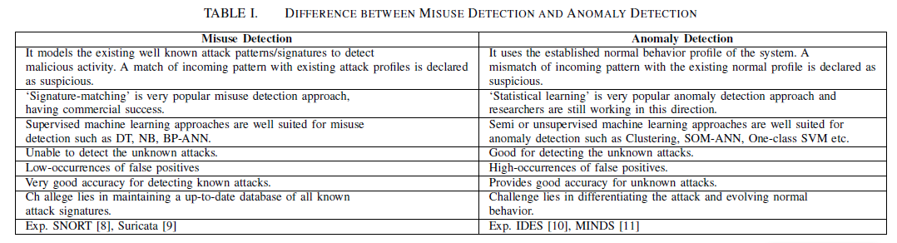
TABLE I. DIFFERENCE BETWEEN MISUSE DETECTION AND ANOMALY DETECTION

Slide 12
Hybrid detection
Hybrid detection approaches integrate misuse and anomaly detection approach for detecting attacks.

Slide 13
Advantages of using Machine learning based IDS
Some of the advantages of using Machine learning based IDS over conventional signature based IDS are as follows:
It is easy to bypass the signature based IDS by doing slight variations in an attack pattern whereas Machine learning based IDS based on supervised techniques can easily detect the attack variants as they learn the behavior of the traffic flow.
The CPU load is low to moderate in Machine learning based IDS as they do not analyze all signatures of the signature database as done by signature based IDS.
Machine learning based IDS can capture the complex properties of the attack behavior and improve the detection accuracy and speed than conventional signaturebased IDS.

Slide 14
Different types of attacks keep on evolving. Signature based IDS will require the maintenance of the signature database time to time and keep it up-to-date whereas Machine learning based IDS based on clustering and outlier detection won’t require such update.

Slide 15
The machine learning based intrusion detection approaches have been categorized into four types. These are as follows:
(i)Single classifiers with all features of data set
(ii) Single classifiers with limited features of data set
(iii) Multiple classifiers with all features of data set
(iv) Multiple classifiers with limited features of data set

Slide 16
RELATED WORKS
Intrusion detection related works :
1. Haq et al. provided a survey on the application of machine learning techniques in intrusion detection.
2. Ahmed et al. provided a survey on network anomaly detection approaches. Attacks are classified into four categories: DoS, probe, U2R and R2L based on KDD’99 dataset.
3. A discussion on machine learning and data mining techniques for intrusion detection has been given by Buczak et al. Their survey describes the application of machine learning and data mining techniques for misuse and anomaly detection.

Slide 17
CLASSIFICATION OF ATTACKS : A. Denial of Service Attacks
In a secure environment, both network and host based security are important. In this Section, we have described attacks which are classified into three broad categories based on their characteristics. Attacks are intentional attempts to destroy or gain unauthorized access to a machine or access user’s data in an unauthorized way.
A. Denial of Service Attacks (Resource Depletion and Bandwidth Depletion Attacks) :
This category of attacks cause the unavailability of service to the legitimate users and hence also referred as DoS (Denial of Service) attacks. An attacker can occupy multiple machines (Zombies) and can use them to launch DoS attacks. This kind of DoS is also called as Denial of Service attack (DDoS).

Slide 18
DoS attack is classified into two types:
1. Bandwidth Depletion attacks : In Bandwidth Depletion attack, attacker tries to overload the network by network packets. There are two classes in Bandwidth Depletion attacks:
1.a Flooding attacks
1.b Amplification attacks
2. Resource Depletion attacks : In Resource Depletion attacks, attacker ties up the resources of a victim system.

Slide 19
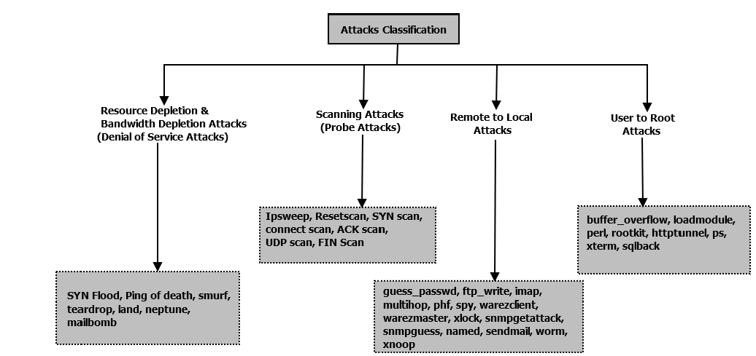
Various Attacks based on KDD’99 dataset :

Slide 20
Different types of attack
Land: In Land attack, an attacker sends spoofed SYN packet in which the source address is the same as the destination address. It is effective in some of the TCP/IP implementations. The attack can be detected by considering the feature ‘Land’. If the value of feature ‘Land’ is 1, it means that source and destination address are identical.
Teardrop: In this attack, the attacker tries to send the fragmented packets to a target machine. He sets the fragment offset in such a way that the subsequent packets overlap with each other. If there is a bug in the IP fragmentation reassembly code of receiving target operating system, the machine crashes due to improper handling of the overlapping packets. Feature ‘Wrong Fragment’ which is the sum of bad checksum packets in a connection provides some clue about the malformed IP packets.

Slide 21
Smurf: Smurf attack is an amplification based denial of service attack in which attacker sends a large number of ICMP echo messages to a broadcast IP address with the spoofed address of victim’s machine as a source IP. On receiving the packet, each machine in the broadcast network replies to the victim’s machine making its resources busy uselessly. This attack can be easily detected in the victim machine by looking at the huge number of ICMP echo replies to victim machine without sending any ICMP echo requests packets from the victim machine.
Ping of Death: Ping of Death (PoD) is a denial of service (DoS) attack caused by an attacker deliberately sending an IP packet larger than the 65,536 bytes allowed by the IP protocol.

Slide 22
An attempted Ping of Death can be identified by noting the size of all ICMP packets and flagging those that are longer than 65,535 bytes.
Mailbomb: In Mailbomb attack, unauthorized users send a large number of email messages with large attachments to a particular mail server, filling up disk space resulting in denied email services to other users. This attack can be identified by looking for thousands of mail messages coming from a particular user within a short period of time.

Slide 23
SYN Flood: In SYN flood, TCP/IP implementation is exploited. An attacker sends the SYN request to the victim machine. Victim replies by ACK and waits for the reply. The server adds the information of each half-open connection in the pending connection queue. The half-open connections on the victim server system will eventually fill the queue and the system will be unable to accept any new incoming connections. A SYN flood attack can be distinguished from normal network traffic by looking for a number of simultaneous SYN packets destined for a particular machine that are coming from an unreachable host or set a threshold for the duration of time a system has to wait for the reply.

Slide 24
B. Scanning Attacks :
A scanning activity is a growing cyber security concern because it is the primary stage of an intrusion detection attempt that is used to locate the target systems in the network and subsequently exploit known vulnerabilities.
Ipsweep: An Ipsweep is used to determine which hosts are listening on the network by sending many ping packets. If a target host replies, the reply reveals the targets IP address to the attacker. A Network Intrusion Detection System can examine the total number of ping packets coming within a short duration of time.

Slide 25
Reset scan: In Reset Scan, an attacker sends reset packets (RST flag up) to victim machine to determine if the machine is active. If the victim machine does not send any response to reset packet; the machine is alive. These scans can be detected by examining the various RST packets coming to a vulnerable machine with same service within a short period of time.
SYN scan: SYN scan is a half-open scanning attack because the attacker does not make a complete TCP connection. Attacker sends a large number of SYN packets to different ports. Open ports respond with SYN-ACK, and close port responds with RST. These scans can be detected by checking the connections with large half-open connections with Flag either REJ (connections rejected; Initial SYN elicited, a RST reply) or S1 (SYN’s exchanged nothing further seen)

Slide 26
initiated by attacker machine.

Slide 27
C. User to Root(U2R) Attacks
User to Root (U2R) attack refers to the group of exploits which are used to gain the root access to a machine by an unprivileged local user. These exploits are used in different ways to gain the root access to the machine.
Buffer overflow attack: The attacker exploits the vulnerability of a user program which copies too much data in a static buffer without checking to make sure the data will fit well. The attacker tries to manipulate the data that overflows the buffer and causes arbitrary commands to be executed by the operating system.

Slide 28
Ffbconfig attack: The attacker exploits the ffbconfig program distributed with some OS. Attacker overwrites the internal stack space of the ffbconfigct program which does not perform sufficient bound checking on arguments. The ffbconfig program is a part of FFB (Fast Frame Buffer) Graphics Accelerator.
Loadmodule attack : The loadmodule program loads to dynamically loadable kernel drivers into currently running system and creates to special devices in /dev directory. An attacker exploits the bug present in the loadmodule program to gain root access to the machine.

Slide 29
Perl attack : Perl attack exploits the bugs saved in set-user-ID and set-group-ID scripts present in the Suidperl version of Perl. In this version, the interpreter does not exempt the root privileges properly when changing effective user and group Ids.
Rootkit attacks: Rootkits are stealthy programs which are used to install a backdoor or hidden entry way to the attacker system to bypass the root privileges of the machine. Rootkits allow the attacker to hide many suspicious processes from the machine and install additional software such as sniffier, keylogger to compromise the resources of the machine.

Slide 30
D. Remote to User(R2U) Attacks
Remote to User (R2L) attack refers to those group of exploits which are used to gain local access to the vulnerable machine, provided the attacker can send packets to the victim machine over a network.
Dictionary/Guess Password attack : In Dictionary/Guess Password attack, an attacker tries to make repeated guesses of possible username and password. The attack can be attempted using many services which provide the login facility such as telnet, ftp, pop, rlogin and imap.

Slide 31
FTPwrite attack : In ftp configurations, if ftp root directory or sub directories are not write protected and in the same group of the ftp account. An attacker can add files to these directories such as rhost files and gain access to the machine.
Imap attack: In Imap attack, an attacker tries to exploit the buffer overflows of the Imap server which exists in the authentication code of the login transaction. Attacker sends a carefully crafted text to execute arbitrary instructions.
Xlock attack : In Xlock attack, attackers exploit the unprotected X console of the user to gain access to the machine.

Slide 32
Attacker displays the modified xlock program to the user and waits till the user enters the password in that display. The password is sent back to the attacker by the trojan version of xlock program.
Wazermaster attack : In wazermaster attack, an attacker tries to exploit the bug present in the FTP server. If FTP server has given write permissions to the guest account, an attacker can login to guest account in the public domain of FTP servers and can upload ‘warez’ (copies of illegal software) into the server. Users can later download these files [74]. Warezclient attack is launched by a legal user during FTP connection after the execution of warezmaster by an attacker. Users download the files (illegal software copies) from the server that were previously created by warezmaster.

Slide 33
Difference between R2L and U2R attacks : There is a little difference between R2L and U2R attacks. In U2R attacks, it is assumed that user has the local privilege to the victim machine (obtained via R2L attack). Attacker tries to attain the root privileges after accessing the machine. Hence the values of the traffic feature will be similar to the normal connection in case of U2R and least important to consider. The basic and content features are important in this case whereas in R2L attacks, attacker tries to obtain the local access to a remote machine. In R2L all features are important.

Slide 34
On the basis of UNSW-NB attack dataset, attacks have been categorized into 9 types. They are described below:

Slide 35
E. Fuzzers
In fuzzer attack, attacker sends a large amount of randomly generated input sequence from command line or in form of protocol packets. Attacker tries to discover security loopholes in the OS, program or network and make this resources suspended for a time period and can even crash them.
If a source is sending large number of packets continuously using same service protocol and/or at same destination port number over some duration of time. It could be indication of Fuzzer.

Slide 36
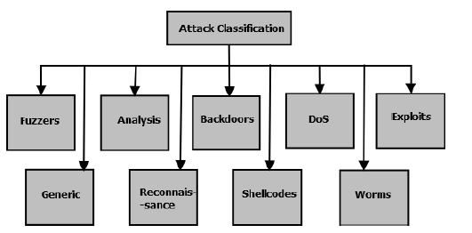
Various Attacks based on UNSW-NB dataset

Slide 37
F. Analysis
This category of attack refers to various intrusions that penetrates the web applications by various means such as port scanning, malicious web scripting (like HTML files penetration) and sending spam emails etc.
The attack characteristics of various port scanning attacks and various important features for detecting these attacks. in addition to source IP address, the analysis of overall network performance can be done by considering various possible features.

Slide 38
G. Backdoor
In backdoor attack, attacker can bypass the normal authentication and can obtain unauthorized remote access to a system. Attacker tries to locate the data by doing fraudulent activities to bypass the system security of the system. Hacker uses backdoor programs to install the malicious files, modifying the code or gain access to the system or data.
Some of the important features that must be present in the feature set are as follows: fsport, dsport, dur, sbytes, service, ackdat, sjit, djit, ct flw http mthd, is ftp login, ct srv src, ct dst ltm g. It won’t be easy to get exact information about a backdoor attempt at victim machine. However, by analyzing network features, one can get some clue about unauthorized network attempts.

Slide 39
H. Exploits
Exploits category refers to intrusions that exploit the software vulnerabilities, bug or glitch within the operating system or software. Attackers utilize the knowledge of the software to launch exploits with an intention to cause harm to the system.
Exploits can be more appropriately detected by monitoring the operating system behavior using dynamic analysis techniques. Once can refer our work for same.

Slide 40
I. Generic
Generic attack against a cryptographical system, tries to break the key of the security system. It is independent of the implementation details of the cryptographic system. The structure of the block-cipher is not considered. For example, birthday attack is a Generic attack which considers hash function as a black box.

Slide 41
J. Reconnaissance
Reconnaissance refers to attacks that gather information about the target computer network in order to bypass its security control. It can be defined as a probe which is a preliminary step towards launching further attacks. Attacker use port scanning OS scanning, nslookup, dig, whois, etc. to gather information about the system. Depending on TCP responses collected for each crafted packet we can make an intelligent guess of the operating system. After collecting sufficient information, attacks such as DDoS, worm, bufferoverflow exploits etc. can be launched.
Various important network features to detect such attacks: fsport, dsport, srcip, dstip, dur, spkts, sinpkt, service, synack, ct srv src, ct src ltm, ct dst ltm g.

Slide 42
K. Shellcode
A shellcode is used as a payload which is executed in the target machine to exploit the software’s vulnerability. It is called as shellcode as it starts a command shell which is under the control of the attacker. Local shell codes try to exploit the vulnerability of high privileged process on a local machine for ex. bufferoverflow. Remote shellcode targets a vulnerable process running on a remote system. On successful execution, an attacker gains the remote access to the local machine. For ex. bindshell connects the attacker to a certain port of victim machine.
These types of attacks fall under the category of low-frequency attacks and can be launched easily at remote machines in a few attempts of making a network connection to the remote machine.

Slide 43
L. Worms
Worms are malicious programs or malware that replicate themselves and spread to other computers. It uses the network to spread the attack. Most of the worms are designed to replicate and do not try to change the system files. However, they can cause disruption to the services by increasing network traffic.

Slide 44
MACHINE LEARNING: TECHNIQUES AND FEATURE SELECTION
In this Section, we have discussed various most popular machine learning techniques used for detecting Intrusions. These techniques hold different characteristics and provide different results for detecting intrusions. Here, we have mentioned the working of these techniques with their characteristics

Slide 45
A. Techniques used in Machine Learning
Machine learning techniques work in two phases: training and testing. In training phase, they perform the mathematical calculations over the training dataset and learn the behavior of traffic over a period. In the testing phase, a test instance is classified as normal or intrusive based on the learned behavior. Various popular machine techniques are described below:

Slide 46
1) Decision Tree:
Decision tree learning methods use branching method to illustrate every possible outcome of a decision. They can work with discrete-value attributes and continuous value attributes as well. The learned trees are then represented in the form of if-then rules. Three basic elements of the tree are decision node, branch and leaf node as shown in figure Decision node specifies a test over some attribute. Each branch represents one of the possible values for this attribute. At last, leaf node represents the class to which the object belongs.
Some of the important decision tree algorithms are ID3, C 4.5 , CART , LMT Tree, etc.

Slide 47
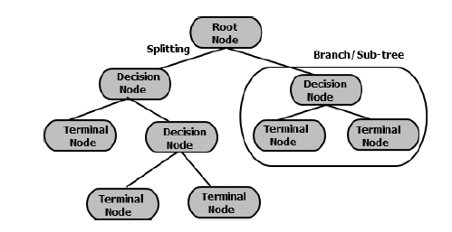
Graphical representation of Decision Tree

Slide 48
A decision tree is suitable for the problems where
(a) Instances can be represented by attribute-value pairs. Each attribute can have a disjoint set of possible values.
(b) Target function should have discrete output value (for ex. yes or no).
(c) The training data may have errors. Decision trees are robust to errors.
(d) Training data may contain missing attribute values

Slide 49
2) Artificial Neural Network(ANN):
Neural Network Learning methods provide a robust approach for approximating realvalued, discrete-valued and vector-valued target functions. The Multi layered Perceptrons Back Propagation Algorithm, Adaptive Resonance Theory based, Radial Basis Functions based, Hopfields Networks and Neural Tree are some examples of classification algorithms using Neural Network.
ANN consists of three main elements: input node, hidden nodes (processing elements in hidden layers) and output node as shown in Figure.

Slide 50
Multi-layer perceptron (MLP) neural network trained by Back-propagation learning (BPL) consists of two stages: feed forward and back propagation. Input data are fed to every node of hidden layer in feedforward stage. Each hidden node and output node calculates its activation value.
The difference between the output target and the desired target value is used to generate an error. In back-propagation stage, the error is propagated back from the output layer to input layer, and weights are adjusted between output nodes and hidden nodes. The gradient descent method is used to update weights. The weights are updated till a predefined threshold is reached.

Slide 51
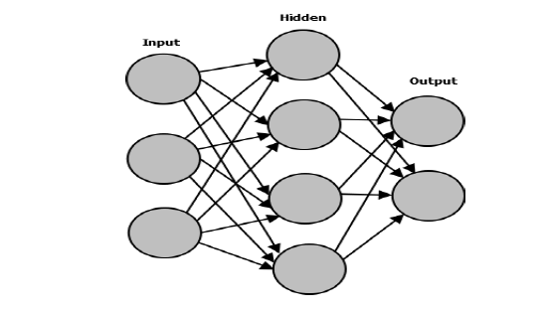
Input, Hidden and Output layers in Neural Network

Slide 52
Neural Networks are suitable for the problems where
a) Instances are represented by many attribute-value pairs. These values can be highly co-related or independent of each other.
b) The target function output may be discrete-valued, real-valued or vector of real or discrete values.
c) Training sample may contain errors. ANN is robust to noise.
d) The learned function is typically difficult to understand by human and this ability to understand the learned target function is not important by human.
It requires larger dataset and the output performance depends on the trained parameters and dataset relevant to the training.

Slide 53
3) Naive Bayes Classifier:
Naive Bayes classifier is based on the Bayesian learning method and it is found to be useful in many applications. It is called ”naive” because it is based on the simplifying assumption that attribute values are conditionally independent of each other. It is applied to the learning task where each instance x can be described by a conjunction of attributes and where the target function f(x) can take any of the value from some finite set V (a set of target values). In the learning steps various P(vj) and p(ai—vj) are estimated, given a training dataset with features set fa1; a2; a3::::::aig of i attributes. It estimates the posterior probabilities of observing a class label from a set of normal class and anomaly class labels. For a given test instance, Class label with largest posterior.

Slide 54
It is suitable for the problems where
a) Target function should have discrete output value (for ex. yes or no).
b) Attribute-value pairs can represent instances.
c) The independent assumption of Naive Bayes is acceptable
Naive Bayes classifier achieves a fast speed of detection and is simpler than other classifiers. However, it makes an assumption that features are independent of each other.
Hidden Naive Bayes is an extension of Naive Bayes and relaxes this assumption. It achieves an accuracy of (99.6%) for DoS attack detection.

Slide 55
4) Support Vector Machine:
Support Vector Machine is one of the most successful machine learning technique in Intrusion detection when applied with other classifiers. SVM is based on the notion of the margin-either side of the hyperplane that separates two data classes as shown in Figure.
The generalization error can be reduced by maximizing the margin and creating the largest possible distance between the separating hyperplane and instances on either side of it.Data points that lie on the margin of optimum separating hyperplane are known as support vector points and solution is represented as a linear combination of these points. If the data contains misclassified instances, SVM may not be able to find the separating hyperplanes. One of the solutions to this problem is mapping the data to a high dimensional space called ‘feature space’ and define separating hyperplane there.

Slide 56
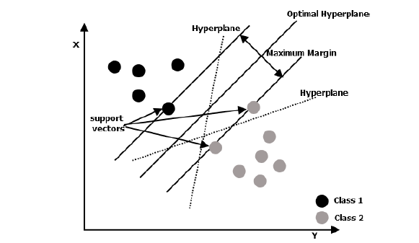
Multi-class Linear SVM

Slide 57
SVM algorithms can be categorized into two types based on the type of kernel function:
Linear SVM
and Non-linear SVM
Based on the type of detection (misuse/anomaly), SVM can be categorized into two types:
Multi-class SVM
and one-class SVM.

Slide 58
Multi-class classification using SVM can be done in two ways: one versus all (the traditional way) and one versus one. In one versus one, a set of binary SVM classifiers are built and the class is selected that is predicted by most of the classifiers. One class SVM is unsupervised machine learning algorithm used for novelty detection.
SVM suffers from the drawback of extensive memory requirement and algorithmic complexity. The performance also depends on the choice of the kernel function and choosing the parameters of kernel functions. Although it is robust to Noise.

Slide 59
5) Genetic Algorithms:
Genetic Algorithms (GA) are search algorithms that find an approximate solution based on the principles of natural selection and genetics. The four operators used in this process are initialization, selection, crossover, and mutation as shown in Figure.
GA evolves to a high-quality population of individuals starting from the arbitrary selected initial population. Each is called a chromosome and is composed of a predefined number of genes. The quality of genes is measured by its fitness function and quantitative representation of each rule’s adaptation . During this process, the initially selected population is evolved for some generations. In each iteration, the three operators: selection, crossover, and mutation are sequentially applied to each with certain probabilities.

Slide 60
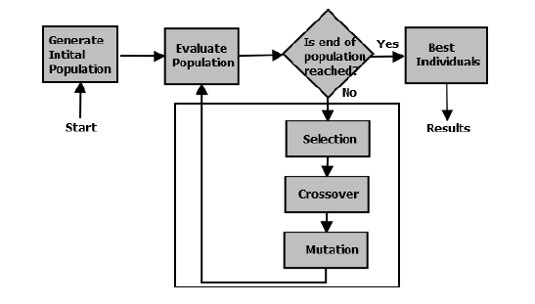
Execution Flow of Genetic Algorithm

Slide 61
Some of the characteristics of GA are:
a) They are intrinsically parallel, they can explore solution space in multiple directions at once.
b) They are well suited for the problems where the space for the potential solutions is truly large.
c) They are an adaptable system with GA and can be easily retrained which provides the possibility of generating new rules for Intrusion Detection.
d) No gradient information is required.
e) Do not require complex mathematics to execute.
f) They work with a population of solutions rather than a single solution

Slide 62
6) K-means Clustering:
K-means algorithm is a clustering based anomaly detection algorithms. They are based on the assumption that normal data instances lie close to their closest cluster centroid while anomalies lie far away from their closest cluster centroid . In the first step, the data is clustered into K clusters assuming any K data points as the centroid of different clusters. The other data points are assigned to the clusters based on their closest distance measure from the centroids. In the next step, the centroid is recalculated as an average of data points of the cluster for each cluster. The process is repeated till some stopping criteria is reached such as till there is no change in centroid as shown in Figure.
The techniques fail if the anomalies in the data form the clusters by themselves.

Slide 63
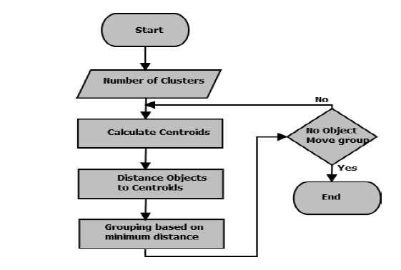
Execution Flow of K-means Clustering

Slide 64
7) K-Nearest Neighbor Approach:
K-NN is an instance based learning algorithms. KNN comes under nonparametric lazy learning algorithms . Nonparametric means that it does not make any assumptions on the underlying data distribution. Lazy means it delays the generalization until the classification is performed. The training phase is much faster than other classifiers but more computational time is involved during the classification process. It is based on the assumption that instances in a dataset will exist in close proximity to other instances that have similar properties. It also assumes that normal data instances occur in dense neighborhoods while anomalies occur far from their closest neighbors. The label of the unclassified instance can be determined by looking at the class label of its neighbor instance.

Slide 65
The Nearest Neighbour based anomaly detection techniques can be grouped into two broad categories:
(1) Technique in which distance between a data point and kth neighbor is used as anomaly score.
(2) Technique in which relative density of each data point is calculated as an anomaly score
They are some important characteristics of kNN such as
a) They are unsupervised and do not make any assumption regarding the generative distribution for the data.
b) They are sensitive to the choice of similarity function which is used to compare instances.

Slide 66
c) They require large storage.
d) Computationally expensive technique.
e) They are not robust to noise and can misclassify instances if noise is present.

Slide 67
8) Fuzzy Logic:
Fuzzy logic is a form of many-valued logic that deals with approximate rather than fixed and exact reasoning. Fuzzy logic offers rigor of formal methods without requiring undue precision. It also offers alternative methods to handle policy preferences and conflicts. A fuzzy set theory is defined in terms of fuzzy logic. Semantic of fuzzy operators are understood by using geometric model. Fuzzy logic can interpret the properties of a neural network and a precise description of its performance can be obtained. Neuro-fuzzy is very popular in the area of Intrusion Detection.
Fuzzy logic is not enough to detect all types of attacks. It performs well when it is integrated with other classifiers.

Slide 68
The key characteristics of fuzzy logic are as follows :
(a) The fuzzy rules allow constructing the if-then rules which can be easily modified based on security applications.
(b) They can combine the input from varying sources.
(d) The quantitative measures used by IDS such as connection interval, CPU usage time, etc. are fuzzy in nature.
(e) A numerical value can belong tomultiple fuzzy sets at the same time, i.e. a numerical value does not have to be fuzzified using only one membership function.
(f) The degree of alert that can be produced by an IDS is often fuzzy

Slide 69
9) Hidden Markov Model:
A Markov Model produces a behavioral model which is composed of states, transitions and actions. Both Hidden Markov Models (HMM) and Markov Chains come under the category of Markov Models. In Markov Chain, the transition probabilities are known which determine the topology of the model. In HMM, the system being modeled is represented by a Markov process with unknown parameters. HMM can be defined as a tool for presenting the probability distribution of a sequence.

Slide 70
10)Swarm Intelligence:
A swarm can be considered as a group of cooperating agents which work together to achieve some purpose and task. Swarm Optimization is an advanced machine learning algorithm which is based on the evolutionary computations.

Slide 71
11)Ensemble of Classifiers/ Ensemble Learning:
Ensemble learning makes use of multiple learners and combines the predictions made by a set of classifiers called as base learners. The use of multiple machine learning algorithms helps in generating a set of hypotheses for a problem. The ensemble of classifiers integrates the hypotheses to generate a common result. The ensemble of classifiers provides a stronger generalization capability compared to individual base learners. Each base learner is generated by using machine learning algorithms such as Decision Tree, Naive Bayes, Neural Network, Support Vector Machine etc.
Random Forest is one of the popular ensemble classifiers which combines the predictions made by the multiple decision trees.

Slide 72
B. Feature Selection in Machine Learning
The goal of feature selection is to select the most important and optimal subset of features. Features selection improves the generalization performance, reduces the computational cost of the classifier and makes the classifier faster for detecting unseen data and simplifies the understanding of data processing.
The feature selection methods are categorized into three types :
(i) Filter methods
(ii) Wrapper methods
(iii) Hybrid/Embedded methods.

Slide 73
SUMMARY OF IDS BASED ON SINGLE/MULTIPLE CLASSIFIER BASED MACHINE LEARNING APPROACHES
Machine learning techniques have been used in different ways for detecting intrusions using publicly available datasets such as KDD’99, DARPA 1998.Recent attack datasets such as ISCX 2012 and UNSW-NB15 has been used in some of the approaches for validation.
By the gradual evolution of machine learning techniques in intrusion detection, we have classified them into four categories. (i) Single classifiers with all features. (ii) Single classifiers with limited features. (iii) Multiple classifiers with all features (iv) Multiple classifiers with limited features. These techniques have been described in detail below:

Slide 74
A. Single Classifier with all Features
1. Kim et al. proposed a misuse detection approach which applies Support Vector Machine (SVM) for Network Intrusion Detection using KDD’99 dataset.
The approach is achieving 91.6% detection rate for detection DoS, 36.65% for Probe attack and 12% for U2R attack and 22% for R2L attacks. Researchers have not reported the results for false alarms.
2. Amor et al. performed the Intrusion Detection using two different misuse detection approaches particularly Naive Bayes and Decision tree classifier separately and compared their performance. The KDD’99 dataset is used for training and testing.

Slide 75
Both are performing very poor in detecting the low-frequency attacks (U2R and R2L). NB achieves detection rate of 96.65% for DoS and 88.33% detection rate for probe whereas DT achieves 97.24% detection rate for DoS and 77.92% detection rate for probe attack. The detection rate is low (0.53%-11.84%) for both approaches.
3. Bouzida et al. performed the Intrusion Detection System using Back Propagation Neural Network (BPL NN) classifier and Decision tree separately for misuse detection and compared their performance. They performed experiments on a KDD’99 dataset for training and testing.

Slide 76
The modified C4.5 algorithm provides improvement for low-frequency attacks too. DT provides the detection rate of 99.99% for DoS, 99.78% for probe, 90.39% for U2R and 98.93% for R2L attacks.
4. Tajbakhsh et al. proposed the misuse detection approach based on fuzzy association rules using KDD’99 dataset.
It provides 78.9% DR for DoS attack detection, 88.5% DR for probe attack, U2R DR for 68.6% and R2L DR for 6.2% attack. The overall detection rate is 70%-90% with 2% false positives.

Slide 77
5. Kumar and Yadav proposed the simplest model of misuse detection system which is based on Neural Network.
The learned classifier is tested over the testing data set. Neural Network is found performing well for detecting Intrusions except for low-frequency intrusions (U2R and R2L).
6. Amoli et al. proposed an unsupervised clustering based anomaly detection approach which is based on anomaly detection approach to detect and classify the DoS, DDoS, Probe attacks.

Slide 78
They have considered the ISCX dataset to validate the approach. It achieves 98.39% accuracy, 100% recall, 98.12% precision, 96.39% TNR and 3.61% FPR and outperforms the K-mean outlier detection.
7. Bhamare et al. presented the use of machine learning for detecting attacks in the cyber network.
DT provides an accuracy of 88.67%, NB provides 73.8% accuracy, SVM with RBF kernel provides 70.15% accuracy, SVM with polynomial kernel provides 68.06% accuracy, SVM with linear kernel provides 69.54% accuracy, and LR provides 89.26% accuracy. DT provides 6.9% FPR, SVM with RBF function provides 4.1% FPR, SVM with poly function provides 53.3% FPR, SVM with linear function provides 50.7% FPR, NB provides 7.3% FPR, LR provides 4.3% FPR.

Slide 79
8. Jazi et al. presented a novel approach for detecting application-layer DDoS attack which uses non-parametric CUSUM algorithm.
The selective sampling provides the best performance with 100% accuracy and no false positive alerts having sampling rate above 20%. A generic sketch-guided sampling also provides good results for detecting applicationlayer attacks. Sketch guided sampling provides 92% detection rate at 40% sampling rate.
9. Wang et al. proposed an intrusion detection framework which uses support vector machine (SVM) integrated with a data transformation method.

Slide 80
It achieves 99.31% accuracy, 99.20% detection rate and 0.60% false alarm rate.

Slide 81
B. Single Classifier with limited Features
Feature selection techniques are used with single classifier approaches to improve its performance. Sangkatsanee proposed a real-time Intrusion Detection System (RT-IDS) based on decision tree C4.5 to detect the two different types of network intrusions such as Denial of Service (DoS) and Probe. The approach is applied in context to misuse detection. The framework consists of three phases: data preprocessing, classification and post-processing.
The technique is not detecting low-frequency attacks. The detection rate for other attacks is higher than 98% with only two seconds of computational speed. It detects DoS attack with 99.434% DR & 0.73% false alarm and probe attack with 98.868% DR & 0.9% false alarms.

Slide 82
1. Amiri proposed Modified Mutual Information based feature selection approach (MMIFS) and used it with Support Vector Machine (SVM) to detect different types of attacks mainly low-frequency attacks. They have considered training and testing dataset of KDD’99.
The method does not achieve detection rate greater than 90% to any of the attack detection. Moreover, the detection rate for U2R attack is lowest (30.70%).
2. Lin et al. proposed a new distance based feature extraction approach (CANN) applied with anomaly detection approach based on a k-NN algorithm to detect intrusions.

Slide 83
The classifier is not able to detect low-frequency attacks. The overall detection rate is 99.99%, accuracy 99.76% and false alarms 0.003%. It achieves accuracy 99% for both DoS and probe attack detection.
3. Koc et al. proposed the Hidden Naive Bayes Classifier which is an extension of the Naive Bayes classifier for misuse detection.
The author provided DoS detection rate as 99.60% and overall detection as 93.72% using KDD’99 dataset.

Slide 84
4. Gharaee et al. proposed the new feature selection based intrusion detection model (GF-SVM) to detect intrusions in the network. A feature selection approach is proposed where a Genetic algorithm (GA) and SVM are integrated to provide an optimal set of features.
It achieves an accuracy of 97.45% with 98.47% TPR and 0.04% FPR for detecting normal traffic. It achieves an accuracy of 79.19%-99.45% with TPR 67.31%-100% and FPR 0.01%- 0.09% for detecting various types of attacks.

Slide 85
5. Bamakan et al. proposed an intrusion detection framework which integrates the time varying chaos particle swarm optimization (TVCPSO) with multiple criteria linear programming( MCLP) and SVM individually for doing parameter tuning and feature selection.
The overall detection rate provided by TVCPSO-MCLP is 97.23% having false alarm rate 2.41% and accuracy 96.88% with feature selection. TVCPSO-SVM provides 97.84% accuracy, 97.03% detection rate and 0.87% false alarm rate with feature selection.
6. Akashdeep et al. provided an intrusion detection approach which uses ANN and combines it with proposed feature reduction

Slide 86
method.
The reduced KDD 99 dataset with 25 features is used to train ANN classifier. It provides 86.6% detection rate (DR) for U2R, 93.8% DR for DoS, 91.9% DR for R2L and 89.8% DR for probe attack.
7. Ambusaidi et al. proposed flexible mutual information (MI) based feature selection (FMIFS) algorithm which can handle linear and nonlinear features efficiently.
It provides 99.46% DR, 0.13% FPR and 99.79% accuracy. When evaluated with NSL-KDD’99, it provides 98.76% DR, 0.28% FPR and 99.91% accuracy. It outperforms other methods like MIFS and Flexible Linear Correlation Coefficient Based Feature Selection (FLCFS).

Slide 87
C. Multiple Classifier with all Features
1. Kumar et al. proposed a multi-objective genetic algorithm (MOGA) for misuse detection.
For ISCX 2012 dataset, it achieves an average detection rate of 97.0% with 2.4% average FPR. It provides 7% improvement in detection rate and reduction in FPR by 96% over MLP and its ensemble using bagging. The proposed approach can enhance the detection rate by 28% and reduce FPR by 51% over the results of MLP trained by back propagation method using KDD cup dataset.
2. Mukkamala et al. proposed the ensemble approach which integrates Artificial Neural Network (ANN), Support Vector Machine

Slide 88
(SVM) and Multivariate Adaptive Regression Splines (MARS).
The approach is providing good accuracy for each category of attacks
3. Zhang et al.proposed hierarchical hybrid (misuse and anomaly detection) framework based on multiple Radial Basis Function Neural Networks (RBF NN) and a clustering algorithm in serial and parallel order. Author proposed another approach named as Parallel Intrusion Detection System (PHIDS).
Parallel framework with multiple Neural Network classifier works better than single classifiers and achieves around 99% detection rate.

Slide 89
4. Toosi et al. proposed a Neural Fuzzy classifier by combining the fuzzy logic with the neural network without using any feature selection technique.
Author has also applied Genetic Algorithm (GA) to optimize the structure of fuzzy decisionmaking system. Author has specified the overall detection rate of the classifier as 95.3% with false positive rate 1.9% over KDD’99 dataset. It has adaptive learning capability. However, it is not working well for low-frequency attacks.
5. Khan et al. proposed the hybrid detection approach by integrating the Support Vector Machine (SVM) with Hierarchical Clustering named as CT SVM using DARPA 1998.

Slide 90
The training time of single SVM is 17.34 hr while integrating it clustering algorithm; it is reduced to 13.18 hr. The system is not working well for detecting low-frequency attacks.
6. Tong et al. presented the Intrusion Detection System which integrates the Radial Basis Function Neural Network (RBF NN) with the Elman Network using DARPA 1998.
adaptable to new intrusions and requires less retraining time. This technique is very helpful in detecting temporarily dispersed and collaborative attacks. The technique is not providing the detection of low-frequency attacks and achieves 100% detection rate for Probe attack.

Slide 91
7. Wang et al. proposed an integrated hybrid intrusion detection approach which consists of Neural Network and Fuzzy Clustering algorithm named as FC-ANN for detecting intrusions.
The technique produces the overall detection rate as 91.32% using KDD’99. The technique improves the detection rate of ANN for lowfrequency attacks.
8. Feng et al. proposed an intrusion detection system (CSVAC) that takes advantage of both misuse and anomaly detection algorithms particularly Support Vector Machine (SVM) and Clustering based Self-Organized Ant Colony Networks (CSOACN).

Slide 92
The classifier provides 3.388 s of training time, but it is not performing well for Probe and U2R attack detection.
9. Elhag et al. combined the genetic fuzzy system (GFS) with the pairwise learni
The approach achieves 99% overall accuracy with 97.77% attack detection rate and 0.191% false alarms. The accuracy is 98.05% for DoS attack, 95.83% for probe attack, 87.54% for R2L and 65.38% for U2R. The approach is achieving the high accuracy for R2L and U2L and outperforming the layered approach discussed above.ng (one to one mapping: OVO) architecture.

Slide 93
10. Yassin et al. proposed the hybrid detection approach which provides integration of K-Means clustering and Naive Bayes classifier.
The approach is implemented using ISCX 2012 attack dataset. It achieves an accuracy of 99.8% with 95.4% detection rate and 0.13% false alarms. The integration improves the accuracy of Naive Bayes which provides 82.8% detection rate and 17.6% false alarms.

Slide 94
D. Multiple Classifier with limited Features
1. Chen et al. proposed a misuse detection approach based on flexible neural Tree (FNT) technique using DARPA 1998.
The algorithm is working well for all categories of attack detection.
2. Xiang et al. proposed a hybrid detection algorithm based on Decision Tree C4.5 and Bayesian (AutoClass) clustering algorithm using KDD’99 dataset.
This classification is well effective for known attacks and results depends on the availability of sufficient label data. This technique is performing low for R2L attacks detection.

Slide 95
3. Lin et al. proposed an algorithm that uses multiple machine learning algorithms to detect the intrusions namely Support Vector Machine (SVM), Decision Tree (DT) and Simulated Annealing (SA) in context of misuse detection.
This technique is performing well for detecting all types of attacks. Especially for DoS, the detection rate is 100%.
4. Casas et al. proposed Unsupervised Network Intrusion Detection System (UNIDS) which uses three algorithms Sub- Space Clustering, DBSCAN and Evidence Accumulation for Ranking Outliers (EA4RO) for anomaly detection.

Slide 96
The algorithm is working well detecting all attacks. Especially for Probe attacks, accuracy is 100% when tested with the KDD’99 dataset.
5. Li et al. proposed a hybrid approach based on Support Vector Machine (SVM), ant colony algorithm and clustering algorithm. There are three phases of classification.
The proposed technique does not perform well for detecting U2R attacks. However, the detection rate is greater than 90% for other attacks.

Slide 97
6. Kuang et al. proposed the misuse detection system based on Kernel Principal Component Analysis (KPCA), Support Vector Machine (SVM) and Genetic Algorithm (GA). SVM provides the good generalization capability over small sample training data.
The overall detection rate is 92.268% with 1.025% false positive rate. However, the technique is not working well for low-frequency attacks.
7. Chandrasekhar et al. proposed a hybrid Model which uses the power of Clustering (K-means), Fuzzy Neural Network (neuro-fuzzy) and Support Vector Machine (SVM) to identify the intrusions.
The algorithm is performing well for detecting all types of attacks

Slide 98
8. Horng et al. proposed a hybrid framework based on hierarchical clustering and Support Vector Machine (SVM) using KDD’99 dataset. To improve the detection rate of SVM and to reduce its training time, Clustering is integrated with SVM.
The system achieves 95.72% accuracy with 0.7% false positive rate. The performance is good for DoS and Probe and poor for low-frequency attacks.
9. Gupta et al. proposed a layered misuse detection approach for achieving high accuracy and high efficiency. The attack accuracy is achieved by using the Conditional Random Fields (CRF) and high efficiency is achieved by using the layered approach.

Slide 99
The layered approach achieves 98.60% detection rate for probe with 0.91% false alarms, 97.40% detection rate for DoS attack with 0.07% false alarms, 86.3% detection rate for U2R with 0.05 false alarms and 29.60% detection rate for R2L with 0.350% false alarms.
10. Mamun et al. proposed a deep packet inspection technique based on the use of Shannon’s entropy to identify the application flows, part of encrypted traffic.
It achieves the detection rate of 96.7% for encrypted traffic and 96.6% for unencrypted traffic with almost similar false alarm 0.03% using ISCX dataset.

Slide 100
11. Chowdhury et al. provided the use of machine learning for network intrusion detection. They have applied the combination of simulated annealing (SA) and Support Vector Machine (SVM) to improve the detection accuracy and reduce the false alarms.
The normal SVM provides an accuracy of 88.03% whereas the proposed scheme provides 98.76% accuracy with a randomly selected three features using SA approach. It provides 0.09% FPR and 1.35% FNR rate which is reasonably low.
12. Moustafa et al. proposed a hybrid feature selection approach to reduce the irrelevant set of features and to integrate it with other machine learning algorithms for intrusion detection.

Slide 101
The results using UNSWNB15 are as follows: EM provides an accuracy of 77.2% with 13.1% FAR. LR provides accuracy of 83.0% with 14.2% FAR and NB provides 79.5% accuracy with 23.5% FAR.
13. Aburomman et al. proposed an ensemble ML based intrusion detection approach in which six k-NN and six SVM classifiers are trained over KDD’99.
It provides 83.6878% accuracy for detecting normal traces, 96.8576% accuracy for probe attacks, 98.8534% for DoS attacks, 99.8029% for U2R attacks and 84.7615% for R2L attacks.

Slide 102
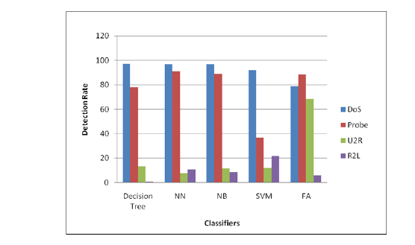
PERFORMANCE ANALYSIS OF DIFFERENT MACHINE LEARNING ALGORITHMS IN INTRUSIONS DETECTION
Performance comparison of single classifiers with 41 features for different Attacks :

Slide 103
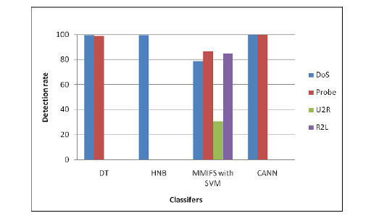
Performance comparison of single classifiers with feature selection

Slide 104
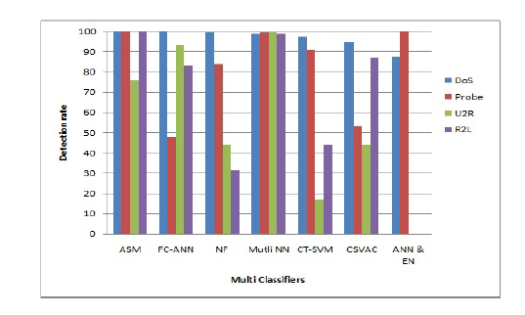
Performance comparison of multiple classifiers with all features

Slide 105
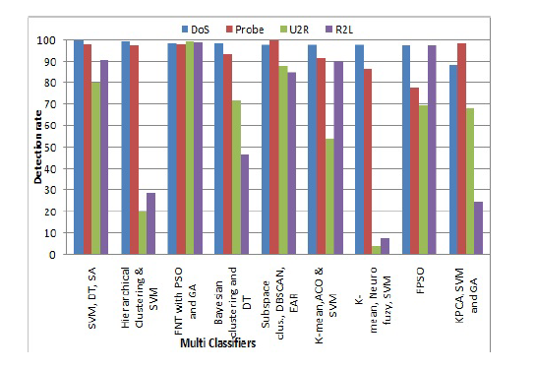
Performance comparison of multiple classifiers with feature selection

Slide 106
DATA MINING TOOLS FOR MACHINE LEARNING
A. Weka
B. Scikit-learn
C. TensorFlow
D. KMINE
E. RapidMiner
F. Environment for Developing KDD-Applications Supported by Index-Structure (ELKI)
G. Massive Online Analysis (MOA)

Slide 107
CONCLUSION
The difficulties associated with detecting the low-frequency attacks using machine learning techniques over network dataset have been described. It motivates researchers to work on other solutions to detect the Low-frequency attacks. Future research directions are provided to help researchers exploring more efficient solutions for attack detection.

